Slide 1
Hotel booking system
Christopher Paradiso
Thomas Soutar
Justin Teutonico

Slide 2
Overview of Program
The hotel booking system is a program that allows hotel employees to easily manage hotel reservations and room service orders.
5 Types of Users:
Admin: Creates managers
Main desk manager: Edits room database
Kitchen manager: Edits menu database
Main desk employee: Checks in and out guests
Kitchen employee: Adds room service orders

Slide 3
Startup
Upon first time use of the program, the admin account will be created.
Beyond the first time setup, starting up the program will give the user a login screen.
The login screen allows the user to either make an account or use an existing one to log in.
If the login information is incorrect, the system will not allow you in.

Slide 4
Setup
The admin can:
Create managers for the hotel and for the kitchen. (This is the only way to add managers)
The hotel manager can:
Add rooms to the hotel, specifying the room, type of suite, and pricing.
The kitchen manager can:
Add items to the menu and set their prices.

Slide 5
Setup
The hotel employee can:
Check all rooms in the hotel (Read-only database access)
Check people in the hotel - includes the feature to see all available rooms
Edit guest information (Read/Write database access)
Check people out of the hotel - guest removed from database and room freed
The restaurant employee can:
Add food orders to the guest’s bill - The user selects the room number and menu items from comboboxes. The user can add and remove menu items from a listbox. The order is added to the bill when done.

Slide 7
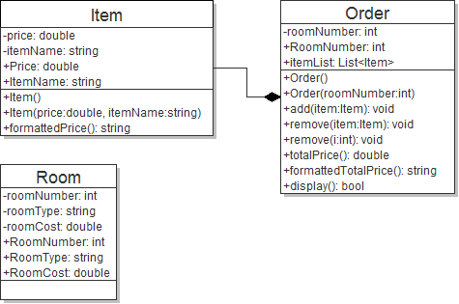
UML

Slide 8
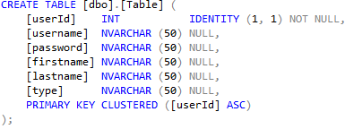
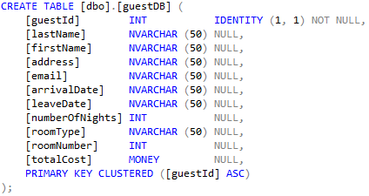
Database

Slide 9
Software security
1-way SHA256 Encryption.
Hash is generated after input and compared with the saved hash.

